Slide 1
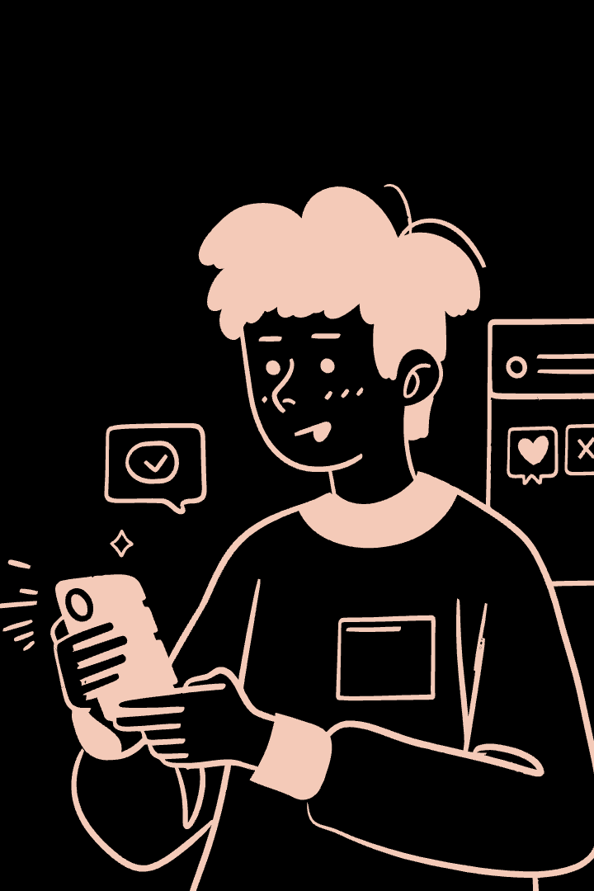
Bridging the Gap: Connecting Alumni and Students
Alumni want to support students. But no platform exists for this. Our app solves this.

Slide 2

Introducing Our Web Solution
MERN Stack App
Built with MongoDB, Express, React, Node.js.
Connects Alumni & Students
A centralized platform for interaction.
Enables Mentorship
Facilitates guidance and support.
Knowledge Sharing
Promotes collaboration and learning.

Slide 3
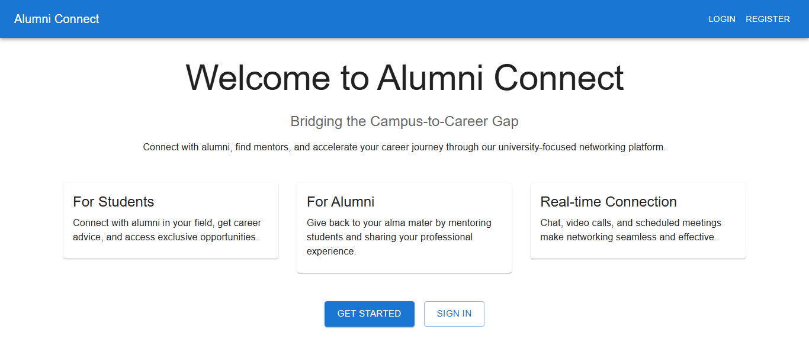

Slide 4
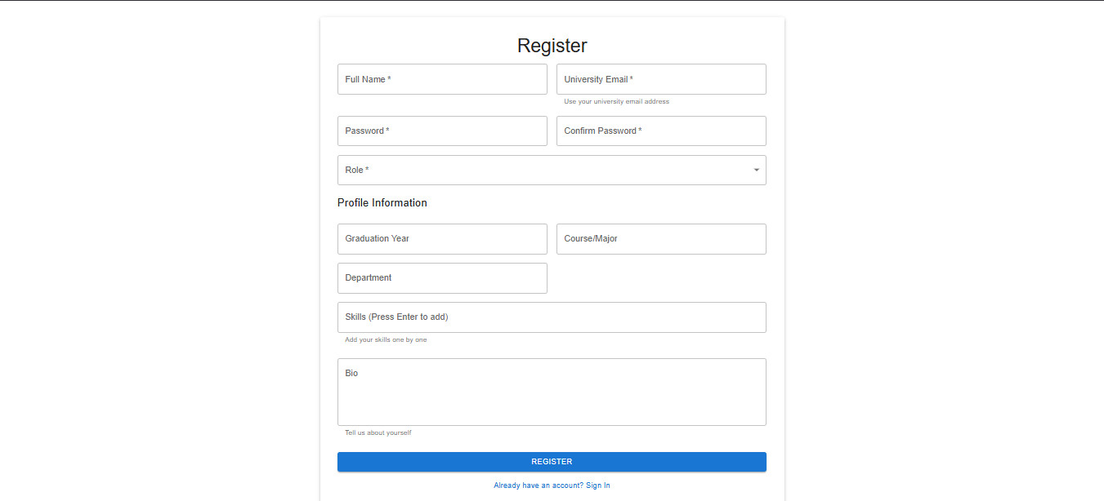

Slide 5
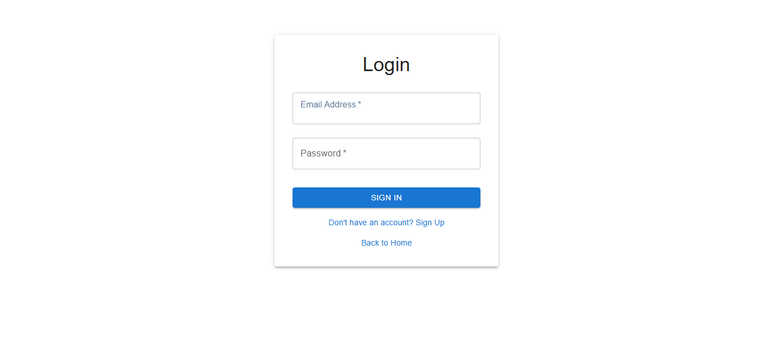

Slide 6
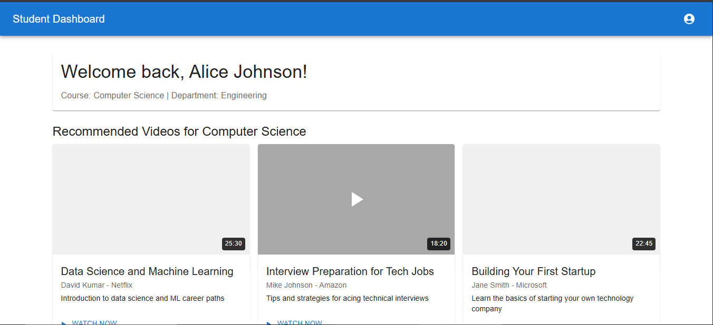

Slide 7
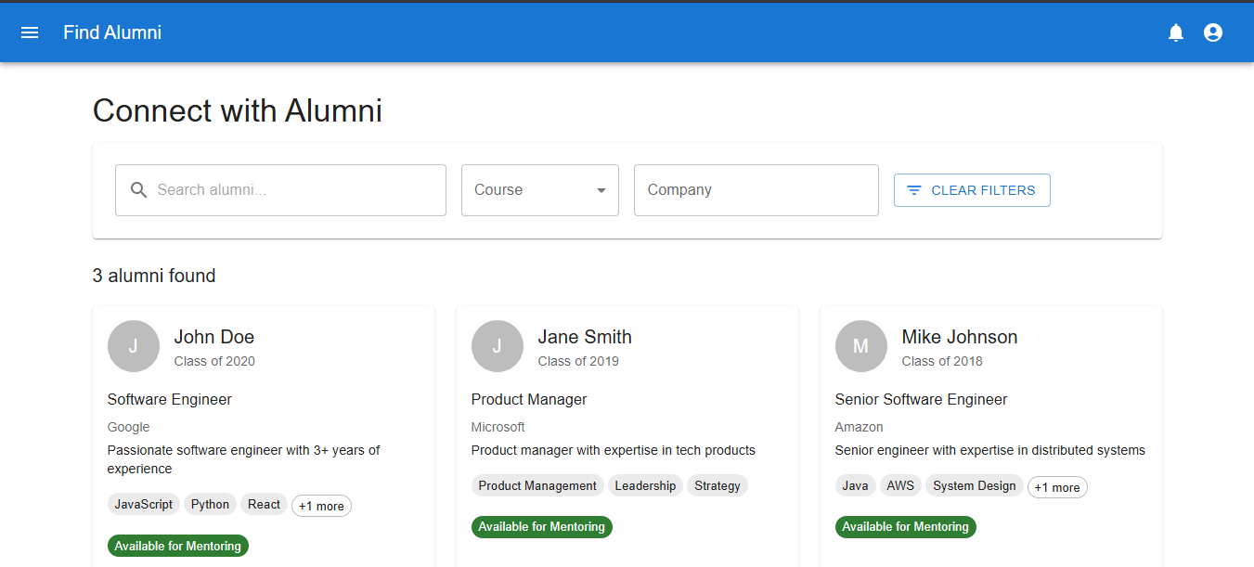

Slide 8
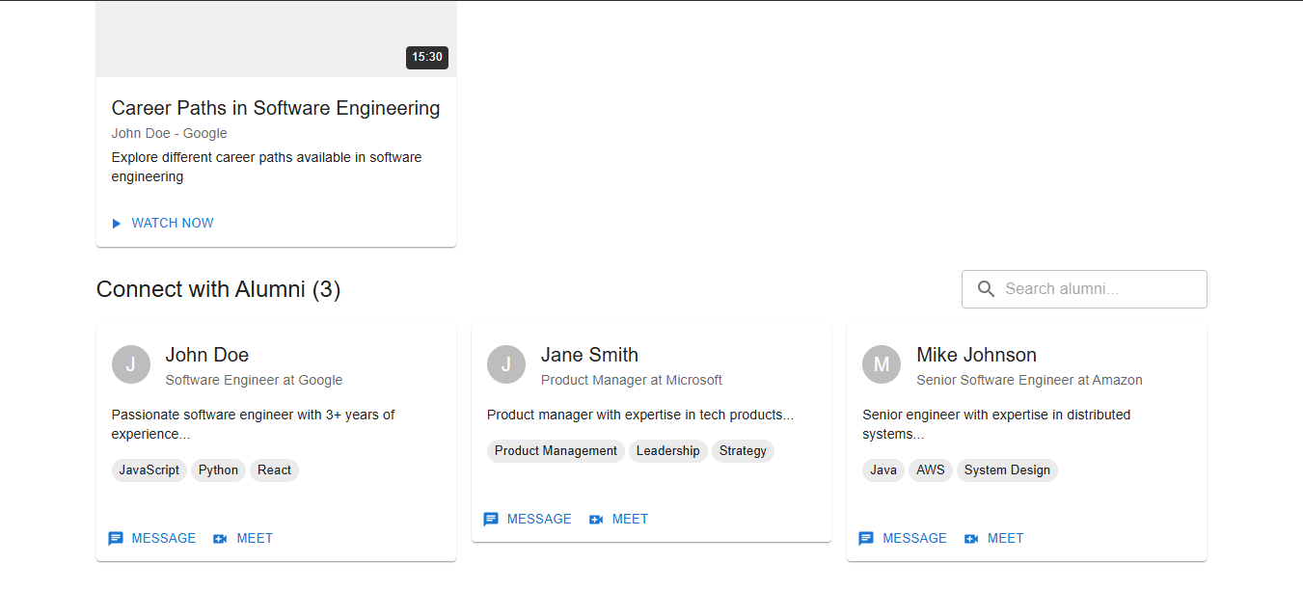

Slide 9
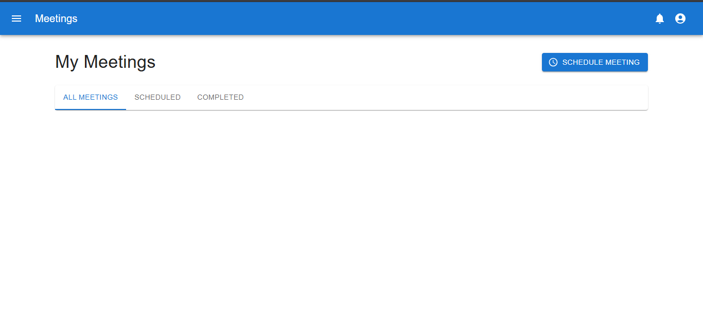

Slide 10
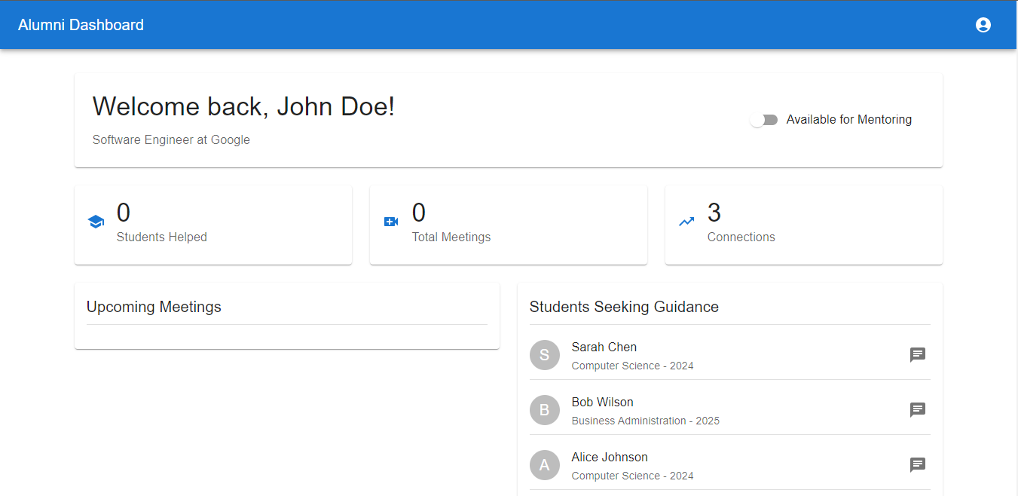

Slide 11
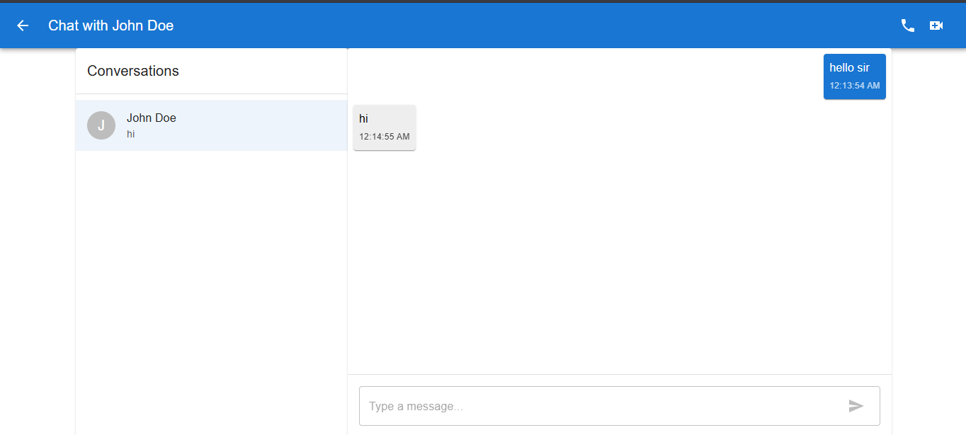

Slide 12
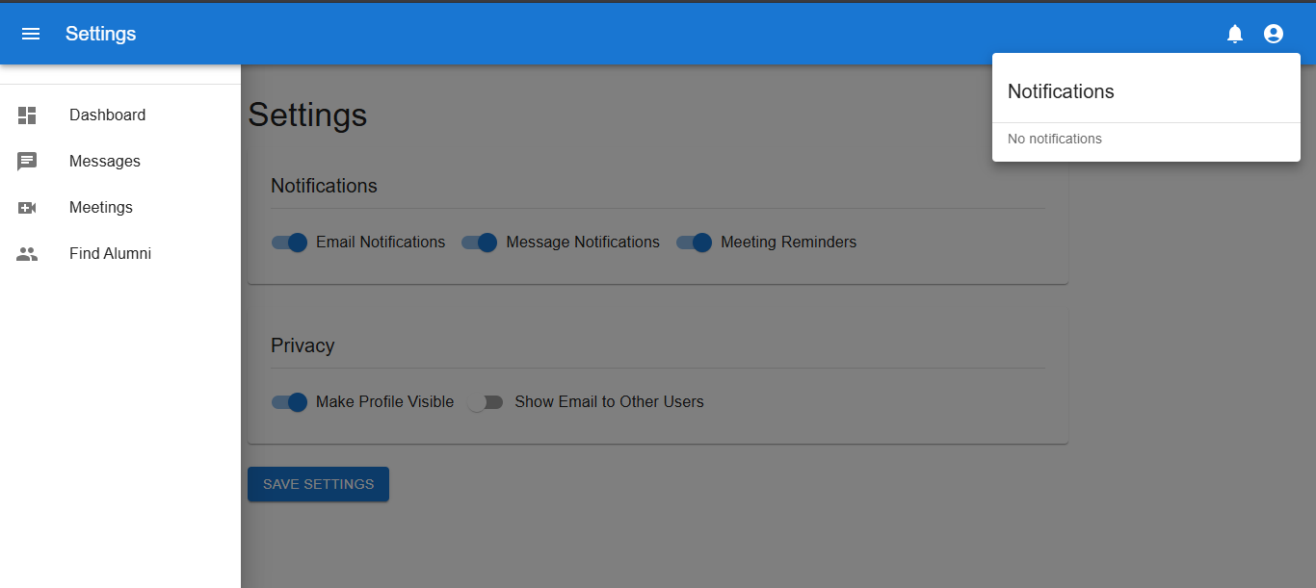

Slide 13
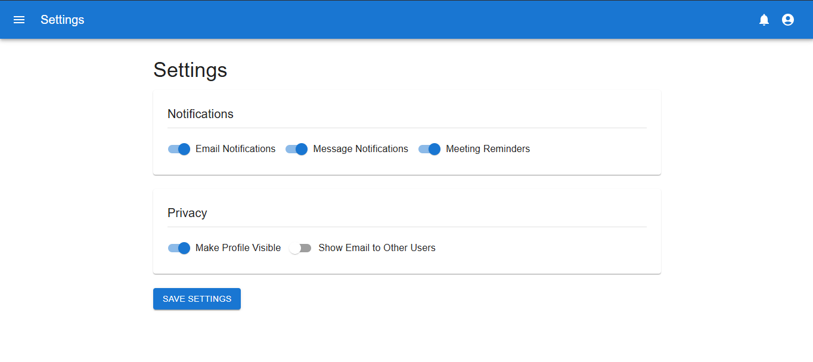

Slide 14
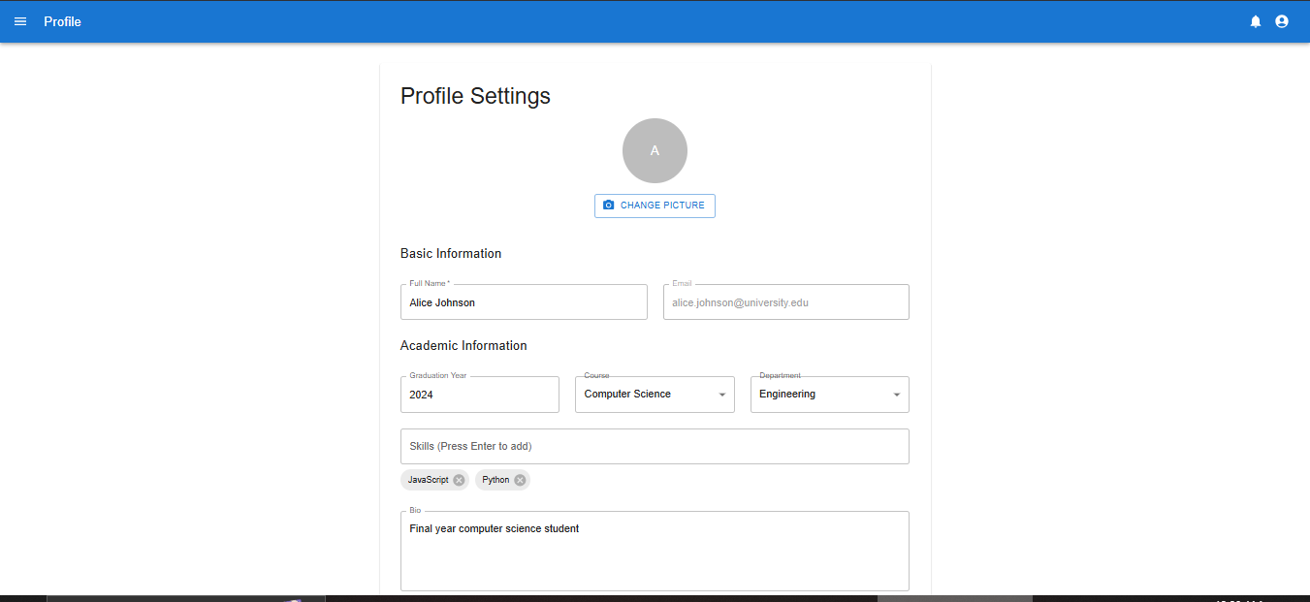

Slide 15
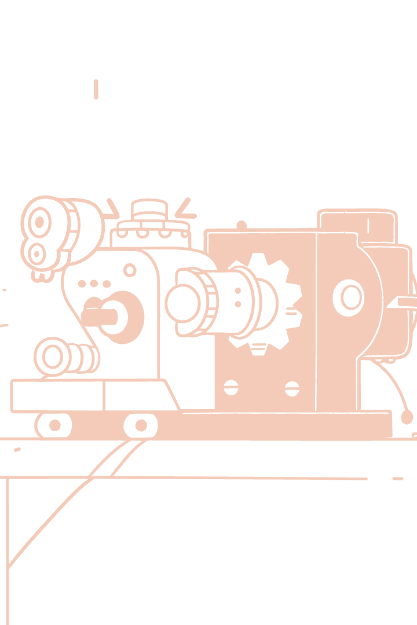




Key Features and Innovations
Student-Alumni Matching
Discussion Forums
Event Announcements
Connects students with alumni
Engage in topical conversations.
Stay updated on networking events.
Resource Sharing
Access valuable educational materials.

Slide 16
Challenges and Solutions
Challenges Faced
Our Solutions
Data privacy concerns.
JWT for secure login.
Secure user authentication.
Role-based access control.
Ensuring user engagement.
Interactive UI/UX design.

Slide 17





Future Scope
Real-time Video Sessions
Instant, face-to-face mentorship.
AI-based Mentor Matching
Smarter, personalized connections.
Mobile Support
Access on the go with dedicated apps.
University Database Integration
Seamless data synchronization.

